Slide 1
Lecture 7:
Project Planning and Estimation (3)

Slide 2
Write it Down!
Project Scope
Estimates
Risks
Schedule
Control strategy
Software
Project
Plan

Slide 3
Estimation
Up to now, we have discussed system size estimation:
  Lines of Code (LOC)
  Function Point (FP)
We are going to estimate the effort (person-month) of developing a system.
  - Directly from the project process
  - From system size to effort
  - Others

Slide 4
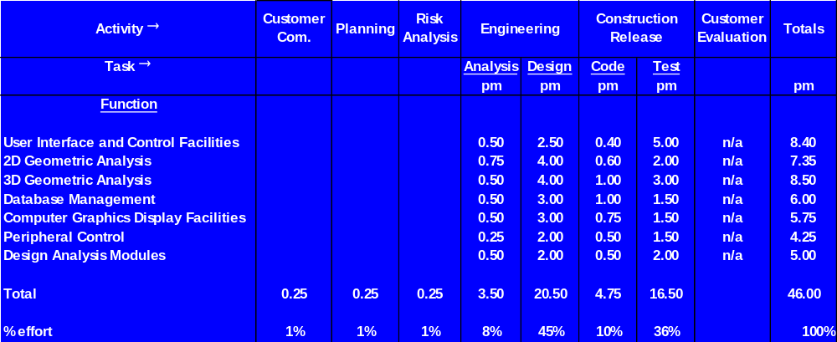
Process Based Estimation
Problem functions and process activities are melded, then the effort (e.g. person-month) is estimated.
Based on an average burdened labor rate of $8,000 per month, the total estimated project cost is $368,000 and the estimated effort is 46 person-months.
Notes:
Note that the early stages apply to the whole system

Slide 5
Empirical Estimation Models
to predict effort based on size and duration.
The general model is
E = A + B × (ev)^{C}
where E is the effort,
A, B and C are empirically derived constants, and
ev (estimation variable) is either LOC or FP
Seven different models (on page 660), which all give different answers for the same values of LOC or FP. This is because they are empirical. So the results must be calibrated to the local situation.
What we have been using is the linear model, in which effort is
proportional to size:
E = A + B × ev
Example: E = -37 + 0.96 × FP (Kemerer regression model)
Notes:
These models are obtained by curve fitting to data from projects.
There is no underlying “theory” behind the equations, they are models of data.

Slide 6
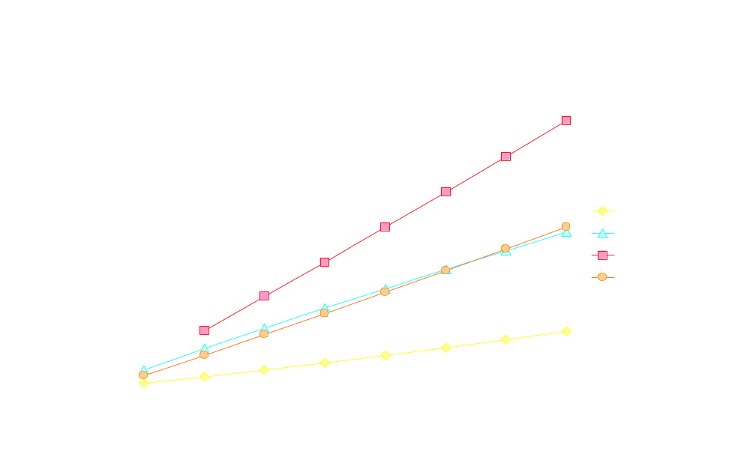
Empirical Estimation Models
Notes:
The white curve (straaight line) is the linear relationship between effort and size, based on 200 LOC/person-month.
The other curves are various models as listed in Pressman (section 23.7.1).
So ifyou want to get a theoretical upper bound use Doty
Lower bound Baley - Basili

Slide 7
The COCOMO II model
COCOMO stands for the COnstructive COst MOdel
It address the following areas:
Application composition model: the early prototyping level
(using object point for the size variable).
Early design stage model: the early design level. Used once
requirements have been stabilized and basic software structure
has been established.
Post-architecture-stage model: Used during the construction of
the software. Size estimate should be more accurate and more
attributes are used to refine the estimation from the second model.

Slide 8
The COCOMO II model
Application composition model:
Step 1: compute object points
object points = Σ (number of objects)*(weight factor)
Weight factors are list below:
Object type | Complexity weight
 | Simple | Medium | Difficult
Screen | 1 | 2 | 3
Report | 2 | 5 | 8
3GL component |  |  | 10
Step 2: estimate reuse percentage (%reuse), if applicable
Notes:
A lot of work has been done on the COCOMO model. It has recently been revised (COCOMO II). This data is from Pressman’s discussion.

Slide 9
The COCOMO II model
Application composition model:
Step 3: compute new object points (NOP)
NOP = (object points)* [(100-%reuse)/100]
Step 4: compute the estimated effort (in person-month)
Estimated effort = NOP / PROD
PROD (productivity rate) is provided in the following table
Developer’s experience/capability | Very low | Low | Nominal | High | Very high
Environment maturity/capability | Very low | Low | Nominal | High | Very high
PROD | 4 | 7 | 13 | 25 | 50
Notes:
A lot of work has been done on the COCOMO model. It has recently been revised (COCOMO II). This data is from Pressman’s discussion.

Slide 10
The Software Equation
The estimation model is:
E = [LOC × B^{0.333} / P]³ × (1 / t⁴)
where
E: effort in person-months or person-years
t: project duration in months or years
B: “special skills factor”,
  e.g. B=0.16 for KLOC = 5 to 15
  B=0.39 for KLOC > 70
P: “productivity parameter”,
  e.g. P=2,000 for real-time embedded software
  P=10,000 for telecommunication and system software
  P=28,000 for business system applications
Notes:
The a parameter has been changed by separating out the EAF factor. That is, the various cost drivers have been explicitly taken into account.
EAF effectively picks up the “Complexity Factors” idea from the Function Point calculation.

Slide 11
The Software Equation
Other variations of software equation:
t_{min} = 8.14 (LOC / P)^{0.43} in months for t_{min} > 6 months
E = 180 B t³ in person-months for E >= 20 person-months
Note: t in the second equation is represented in years.
Example: suppose the LOC = 33,200 for a software, P = 12,000
for scientific software, and B = 0.28, then
t_{min} = 8.14 (33200 / 12000)^{0.43} = 12.6 calendar months
E = 180 * 0.28 * (1.05)³ = 58 person-months
Notes:
The problem with this is the definitions of E and t as “person-months” or “person-years” and t in “months” and “years”.
But t is raised to the power –4, and E is not.
One supposes that months and person-months are intended because the example uses these quantities.
Apart from this, the software community has done a bad job of working with such empirical estimates and trying to make metrics of them..

Slide 12
Make or Buy?
Guidelines:
Develop requirements specification
Estimate internal cost and delivery date
Select externally supplied applications which may be substituted
Develop a comparison chart and/or benchmarks and evaluate
Evaluate other related items, e.g. past product quality, vendor support, product direction, reputation and the like
We can also use decision trees
Notes:
The problem with this is the definitions of E and t as “person-months” or “person-years” and t in “months” and “years”.
But t is raised to the power –4, and E is not.
One supposes that months and person-months are intended because the example uses these quantities.
Apart from this, the software community has done a bad job of working with such empirical estimates and trying to make metrics of them..

Slide 13
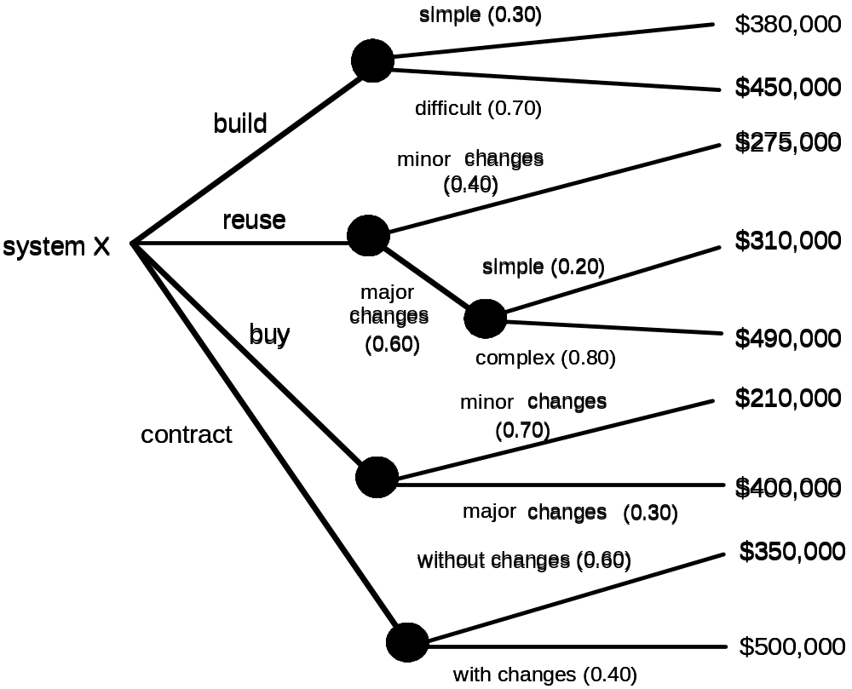
The Make-Buy Decision
Notes:
The problem with this is the definitions of E and t as “person-months” or “person-years” and t in “months” and “years”.
But t is raised to the power –4, and E is not.
One supposes that months and person-months are intended because the example uses these quantities.
Apart from this, the software community has done a bad job of working with such empirical estimates and trying to make metrics of them..

Slide 14
Computing Expected Cost
expected cost =
(path probability) x (estimated path cost)
i
i
For example, the expected cost to build is:
expected cost = 0.30 x ($380K)+0.70 x ($450K)
build
= $429 K

Slide 15
Computing Expected Cost
expected cost =
(path probability) x (estimated path cost)
i
i
Exercise: computing the expected cost for reuse:
expected cost = 0.40 x $275K+0.60 x (0.20 x $310K +0.8
x $490K)
reuse
similarly,
= $382K
expected cost = $267K
buy
expected cost = $410K
contract

Slide 16
Computing Expected Cost
Finally we got the following results for decision:
expected cost = $429K
build
expected cost = $382K
reuse
expected cost = $267K
buy
expected cost = $410K
contract
Decisions can be made based on the results

Slide 17
Summary
Objective of software planning:
  To provide a framework that enables the manager to make reasonable estimates of sources, cost, and schedule
Planning involves:
  Identifying software scope and determining feasibility
  Defining required resources
  Estimating cost and effort
  Scheduling (later session)
  Analyzing risk (later session)

Slide 18
Summary
Estimation is difficult and error prone
Estimation techniques
Decomposition of the product into sub-systems
Decomposition of the process into steps
Conventional estimation methods:
LOC (lines of code)
Reconciling LOC and FP
FP (function point)
Process-based
Empirical estimation (e.g. E = A + B × (ev)^{C} )
COCOMO II model
Software equation E = [LOC × B^{0.333} / P]³ × (1 / t⁴)
Made-Buy decision
Estimates might be wrong and must be revised

Slide 19
Readings
Pressman (6th edition):
  Chapter 23: Estimation for Software Projects
  Section 15.3 Metrics for the Analysis Model (in Chapter 15)
  Chapter 22: Process and Project Metrics
    especially Section 22.2 Software Measurement
  Chapter 21: Project Management Concepts

